Slide 1

Osiris Therapeutics
Fraud Detection
Group 5:
David Ben-Ezra, Stephen Buden, Aiden Cliff, Rohit Punj, Jacob Rose

Slide 2
Roadmap
01
02
03
M-Score
Benford’s Law
Conclusion
Overview of investigation into Beneish’s M-Score weaknesses of Osiris Therapeutics
Overview of investigation into Benford’s Law anomalies of Osiris Therapeutics
Conclusion of investigations

Slide 3
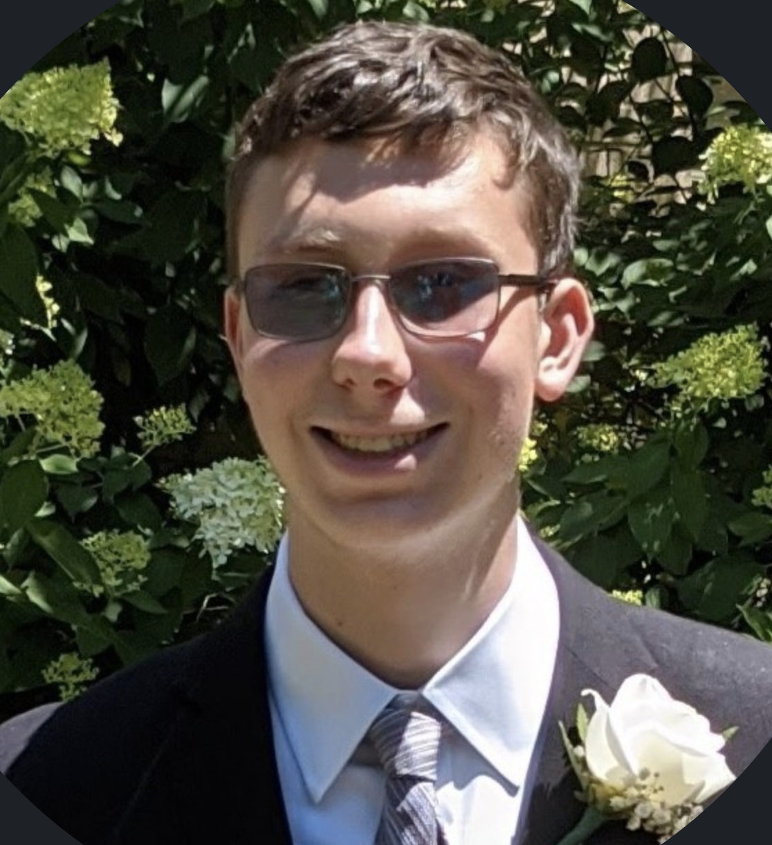




Future Osiris Executives
David Ben-Ezra Stephen Buden Aiden Cliff
Rohit Punj Jacob Rose

Slide 4
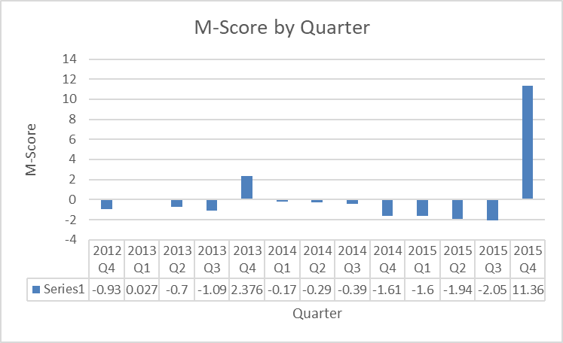
M-Score Analysis

Slide 5
M-Score Limitations for Osiris
Osiris was rapidly growing in its pre-fraud period, so some of the metrics used as part of the M-score, such as sales growth, may have indicated fraud even if it was not present
Osiris did not report its earnings for 2015 until 2018 after the fraud had been discovered and numbers had been adjusted, so the M-score for Q4 2015 is not reliable

Slide 6
Individual: Benford’s Law
Yearly Data
 | 2010 | 2011 | 2012 | 2013 | 2014 | 2015 | 2016 | Total
KS | 15.40% | 18.34% | 18.17% | 12.60% | 22.01% | 14.79% | 14.79% | 9.09%
Cut-Off | 23.32% | 23.32% | 22.36% | 21.50% | 21.50% | 22.67% | 22.67% | 8.48%
Manipulation? | X | X | X | X | X | X | X | ✓

Slide 7
Individual: Benford’s Law
Quarterly Data
 | 2010q4 | 2011q1 | 2011q2 | 2011q3 | 2011q4 | 2012q1 | 2012q2 | 2012q3
KS | 25.21% | 15.49% | 15.49% | 19.81% | 25.84% | 22.18% | 18.74% | 15.52%
Cut-Off | 21.50% | 21.24% | 21.24% | 20.74% | 24.04% | 21.24% | 20.50% | 20.27%
Manipulation? | ✓ | X | X | X | ✓ | ✓ | X | X

Slide 8
Individual: Benford’s Law
Quarterly Data Continued
 | 2012q4 | 2013q1 | 2013q2 | 2013q3 | 2013q4 | 2014q1 | 2014q2 | 2014q3
KS | 18.74% | 12.52% | 16.47% | 12.93% | 12.38% | 11.32% | 24.65% | 18.55%
Cut-Off | 20.50% | 20.50% | 20.50% | 20.05% | 20.05% | 20.27% | 20.27% | 19.84%
Manipulation? | X | X | X | X | X | X | ✓ | X

Slide 9
Individual: Benford’s Law
Quarterly Data Continued
 | 2014q4 | 2015q1 | 2015q2 | 2015q3 | 2015q4 | 2016q1 | 2016q2 | 2016q3
KS | 14.22% | 10.54% | 8.47% | 7.88% | 9.05% | 16.95% | 11.68% | 8.68%
Cut-Off | 20.05% | 20.05% | 20.05% | 20.27% | 22.06% | 22.06% | 22.06% | 20.27%
Manipulation? | X | X | X | X | X | X | X | X

Slide 10
Total: Benford’s Law
Quarterly Data Annual Data
KS | 10.18%
Cut-Off | 4.15%
N | 1074
KS | 9.09%
Cut-Off | 8.48%
N | 257
Since KS > Cut-Off, there is indication of earnings manipulation.

Slide 11
*Included Data
Main line items were included
Main expense and revenue buckets (seen right) were included and broken down
Restatement of financial statements
Due to fraud
Causes lack of relevant (fraud-prompting) information
Current Assets - Total
Cost of Goods Sold
Depreciation and Amortization - Total
Inventory - Finished Goods
Inventory - Raw Materials
Inventories - Total
Inventory - Work in Process
Current Liabilities - Total
Net Income (Loss)
Revenue - Total

Slide 12
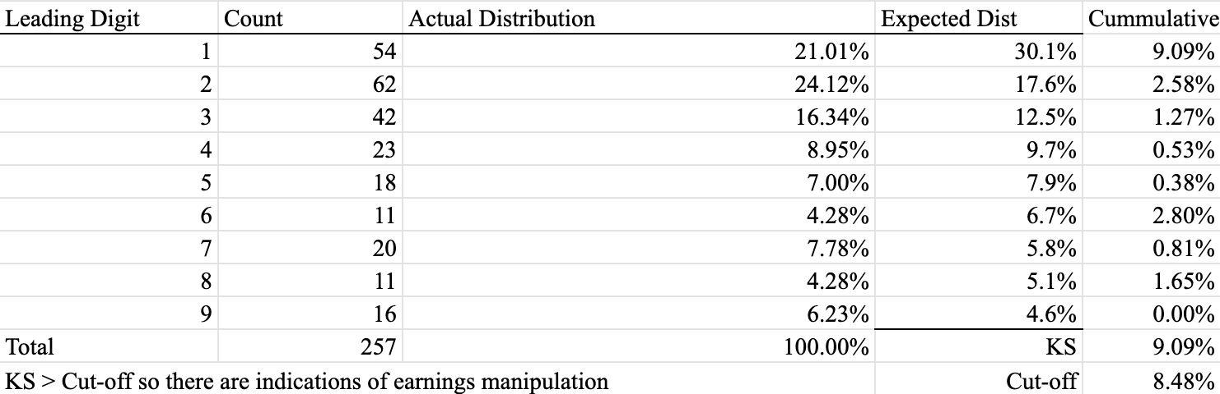
Annual Benford’s Law Distribution (Total)

Slide 13
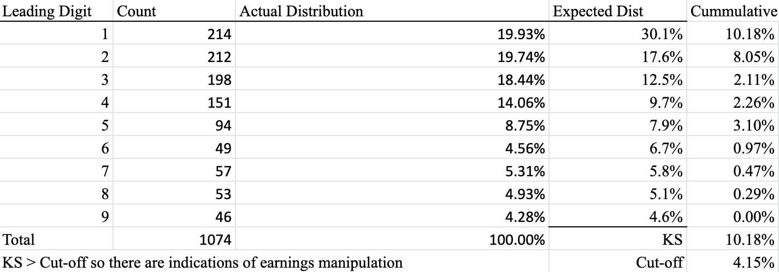
Quarterly Benford’s Law Distribution (Total)

Slide 14
Conclusion
Beneish’s M-Score
M-scores reflect fraud in 21 of 24 quarters studied, from 2010 Q4 - 2016 Q3
Exceptions being: 2015-Q2 & Q3
M-scores reflect fraud in 6 of 7 years studied, from 2010 - 2016
Exception being 2015
Benford’s Law
Fraud detected in both quarterly and annual reports (when studied together)
Individual years flagged 0 of 7 (0%), but overall numbers from 7 year period viewed together suggest EM (KS of 9.09% > Cut-off of 8.48%)
Individual quarters flagged 4 of 24 (16.67%)
Only flagged 1 of 7 quarters during fraud period (14.28%) for 2014 Q2

